Slide 1
Unit –II
Enzymology
(a) Structure, properties and specificity of enzymes
Enzymes are – Thermolabile, organic catalyst elaborated by a living cell & capable of functioning independently.
An enzyme acts by catalysis i.e it increases the velocity of a chemical reaction without being permanently changed.
Berzelius 1835- Define &Recognize the nature of a catalysts.
Kuhne 1878 – Used the word enzyme to indicate catalysis.

Slide 2
Properties of Enzymes :
- Most enzymes are proteins.
- They have a globular shape
- A complex 3-D structure
- Forms colloidal solutions.
- Amphoteric in nature.
- Large molecular weight.
- Nondializable
- Remain unaltered at the end of reaction.
- Active in a small quantities.
- They acts as catalyst- accelerate the rate of
reaction

Slide 3
- Monomeric enzyme – single polypeptide
chain e.g Ribonuclease, Trypsin.
- Oligomeric enzyme – more than one
Polypeptide chain e.g Lactatde hydrogenase.
- Multienzyme complex – possessing specific
sites to catalyze different reactions in a
sequence e.g Pyruvate dehydrogenase

Slide 4
Some enzymes are entirely proteins, others contain nonproteinic component (prosthetic group or co-enzyme) along with proteinic component (apoenzyme). Complete enzyme containing both the components is called Holoenzyme.
Holoenzyme --------> Apoenzyme + Co-enzyme
(Active) (Inactive (Inactive
Protein) Non protein)
prosthetic groups are tightly bound cofactors
Cofactors that are loosely bound and released easily are called coenzymes
Many vitamins are coenzymes

Slide 5
Enzyme Substrate Complex :
E + S -----> ES -----> E + P
Turn Over Number : Catalytic power of an enzyme is measured in terms of TON. ---defined as the no. of substrate molecules converted in to product per unit time when the enzyme is fully saturated with substrate.
The value of TON varies with the Enzyme , depends on the conditions in which the reaction takes place.

Slide 6
Extracellular Enzymes : Enzymes produced outside the cell and functioning outside the cell e.g Amylase.
Intracellular Enzymes : Enzymes produced within the cell and functioning inside the cell e.g Catalase.
Constitutive Enzymes : Those enzymes formed by the cell under any or all the conditions of growth.
Induced Enzymes : Enzymes are formed only in response of Inducer.

Slide 7
Specificity of Enzymes :
Enzyme display greater degree of specificity with respect to the nature of substrate acted upon. It is a characteristic property of an Active site.
Types of Specificity :
Absolute Specificity : Enzyme in this group acts only on a single substrate e.g Urease acts only on Urea to produce Ammonia & CO2.

Slide 8
Group Specificity/ Relative specificity : Enzymes capable of catalyzing the reaction of a structurally related group of compounds. This may be dependent on the specific group or a bond present. E.g Proteases acts on peptide bonds of proteins. Glycosidases on glycosidic bonds of carbohydrates and Lipases on ester bond of lipids.
Optical or Stereo Specificity : Enzyme will react with only one of the two optical isomers. e.g Arginase acts on L-Arginine and not on D .

Slide 9
Geometrical Specificity : Enzyme exhibit specificity towards the Cis & Trans forms.
Broad specificity : Some enzymes act on closely related substrates which is commonly known as broad substrate specificity.
e.g. hexokinase acts on glucose, fructose, mannose.
Reaction specificity : The same substrate can undergo different types of reactions, each catalysed by a separate enzyme and this is referred to as reaction specificity

Slide 10
(b) ACTIVE SITE : Catalytic site
Active of an enzyme is a small region at which substrate binds & contribute the residues to participate in catalysis.
Salient features of active site :
1 . Active site occupies relatively small portion of the enzyme molecule
2. Active site is neither a point nor a line or even a plane surface but is a three dimensional native conformation & is due to the tertiary structure of protein.

Slide 11
3. The active site is made up of catalytic amino acids( catalytic residues).
4. The specificity of binding is depends on the precisely defined arrangements of atoms at active site.
5. Active sites are regarded as clefts or crevices.
6. Active site binds the substrates by relatively weak noncovalent bonds.
7. The active site is not rigid in structure and shape. lt is rather flexible to promote the specific substrate binding.

Slide 12
8. The coenzymes or cofactors on which some enzymes depend are present as a part of the catalytic site.
9. The commonly found amino acids at the active sites are serine, aspartate, histidine, cysteine, lysine arginine,glutamate,tyrosine etc.Among these amino acids, serine is most frequently found.
10. The substrate[s] binds the enzyme (E) at the active site to form enzyme-substrate complex(ES). The product( P) is released after the catalysis and the enzyme is available for reuse.
E + S -----> ES -----> E + P

Slide 13
Active site of an enzyme can be determined by :
Use of Competitive inhibitor.
Use of reagents capable of covalently modifying the functional groups at the active site of an enzyme.
Affinity labelling technique.
X – ray diffraction method
Use of heavy metals
Change in PH

Slide 14
(c) Mechanisms of ES complex formation :
E + S -----> ES -----> E + P
Many theories have been put forth to explain the mechanism of enzyme-substrate complex formation.
Lock and key model or Fischer's template theory :
first model proposed by a German biochemist Emil Fischer to explain an enzyme catalysed reaction.
According to this model, the structure or conformation of the enzyme is rigid. The substrate fits to the binding site (now active site) just as a key fits into the proper lock.

Slide 15
the active site of an enzyme is a rigid and pre-shaped template, where only a specific substrate can bind.
does not give any scope for the flexible nature of enzymes.
the model does not give clear idea about the ES complex.
Fischer gave two component of active site : responsible for Substrate specificity and catalysis proper.

Slide 16
Induced Fit Model :
Induced-fit model of enzyme action was Proposed by Koshland in 1958.
In which :
- the active site is flexible, not rigid
- The interaction of the substrate with the enzyme induces a conformation change in the enzyme, resulting in the formation of a strong substrate binding site.

Slide 18
- the shapes of the enzyme, active site, and substrate adjust to maximize the fit, which improves catalysis.
- there is a greater range of substrate specificity
- This model is more consistent with a wider range of enzymes describe the situation more accurately.

Slide 19
Substrate strain theory
In this model, the substrate is strained due to the induced conformation change in the enzyme.
when a substrate binds to the preformed active site, the enzyme induces a strain to the substrate.
Fig :

Slide 21
The strained substrate leads to the formation of product.
ln fact, a combination of the induced fit model with the substrate strain is considered to be operative in the enzymatic action.

Slide 22
(d) Factors affecting Enzyme activity :
The contact between the enzyme and substratei s the most essential pre-requisite for enzyme activity.
The important factors that influence the velocity of the enzyme reaction are :
1. Concentration of Enzymes
2. Concentration of Substrates
3. Temperature
4. pH
5.Product Concentration
6. Activators and Inhibitors

Slide 23
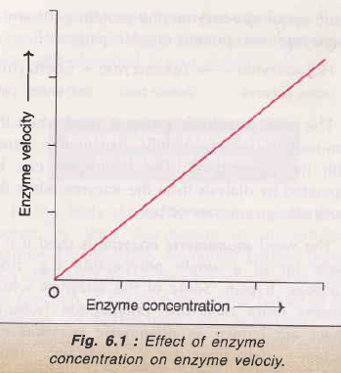
1. Concentration of enzyme :
As the concentration of the enzyme is increased, the velocity of the reaction proportionately increases.
Substrate conc. Should be at saturated amount.

Slide 24
2. Concentration of substrate :
Increase in the substrate concentration gradually increases the velocity of enzyme reaction within the limited range of substrate levels.
A rectangular hyperbola is obtained when velocity is plotted against the substrate concentration

Slide 25
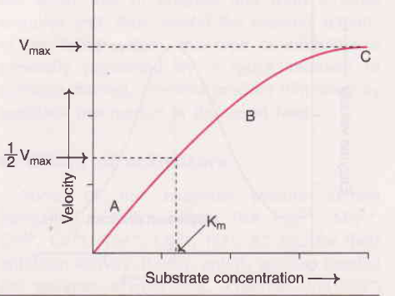
.

Slide 26
3. Effect of temperature :
Velocity of an enzyme reaction increases with increase in temperature up to a maximum and then declines. A bell-shaped curve is usually observed.
Temperature coefficient or Q10 is defined as increase in enzyme velocity when the temperature is increased by 10°C.
For a majority of enzymes, Q10 is 2 between 0°C and 40°C.
lncrease in temperature results in higher activation energy of the molecules and more molecular (enzyme and substrate) collision and interaction for the reaction to proceed faster.

Slide 27
The optimum temperature for most of the enzymes is between 40°C- 45°C.
Few are active even at 100°C, may be due to very stable structure and conformation of these enzymes.
Enzymes exposed to a temperature above 50°C, denaturation leading to derangement in the native (tertiary) structure of the protein
Majority of the enzymes become inactive at higher temp. (above 70°C)

Slide 29
4. Effect of pH :
lncrease in hydrogen ion concentration (pH) considerably influences enzyme activity.
a bell-shaped curve is normally obtained.
Each enzyme has an optimum pH at which the velocity is maximum. Below and above - the enzyme activity is much lower and at extreme pH, the enzyme becomes totally inactive.
Most of the enzymes show optimum activity around neutral pH (6-8).
pH influence the enzyme activity by altering the ionic charges on the amino acids (particularly at the active site), substrate, ES complex etc.

Slide 30
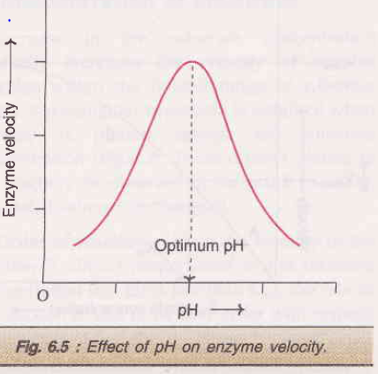

Slide 31
5. Effect of product concentration :
The accumulation of reaction products generally decreases the enzyme velocity.
The products combine with the active site of enzyme and forms a loose complex and thus, inhibit the enzyme activity.
this type of inhibition is generally prevented by a quick removal of products formed.

Slide 32
6. Effect of activators :
Some of the enzymes require certain inorganic metallic cations like Mg2+, Mn2+,zn2+, ca2+, co2+, cu2+, Na+, K+ etc for their optimum activity.
Rarely, anions are needed.
Metals function as activators through various mechanisms : combining with the substrate, formation of ES-metal complex, direct participation in the reaction and bringing a conformational change in the enzyme.

Slide 33
Two categories of enzymes distinguished:
(1) Metal-activated enzymes : The metal is not tightly held by the enzyme and can be exchanged easily with other ions e.g. ATPase (Mg2+ and Ca2+),Enolase (Mg2+).
(2) Metalloenzymes : These enzymes hold the metals rather tightly which are not readily exchanged. e.g.alcohol dehydrogenase, alkaline phosphatase,carboxypeptidase and aldolase contain zinc.Phenol oxidase (copper);Pyruvate oxidase (manganese);Xanthine oxidase (molybdenum);Cytochrome oxidase (iron and copper.)

Slide 34
e) IUB System of ENZYME CLASSIFICATION
International Union of Biochemistry (IUB) in 1961 established a Systematic classification and Nomenclature for Enzyme.
General Features of IUB system :
(I) Enzymes are divided in to Six main classes :
1. Oxidoreductases: Catalyse oxidation – reduction reactions
2. Transferases : Catalyse group transfer reactions
3. Hydrolases : Catalyse hydrolytic reactions

Slide 35
4. Lyases : Catalyse nonhydrolytic removal of group leaving double bonds
5. Isomerases : Catalysing isomerization reaction
6. Ligases : Catalyse the synthesis of new bonds
Each broad class is divided in to subclasses & sub subclasses.
Sub classification describes – nature of co- enzyme involved, type of isomerization, type of bond hydrolyzed etc.

Slide 36
(ii) Each enzymes have a systematic code number.
e.g. Alcohol dehydrogenase – 1:1:1:1
First digit – indicate main class –
1. - Oxidoreductase
Second & Third digit – indicate subclass & sub subclass
1:1 – acting on CH-OH group
1:1:1 – NAD or NADP as acceptor
Fourth digit – serial number of the enzyme.
1:1:1:1 - Alcohol dehydrogenase
(iii) The name of enzyme consist of two parts : First – name of substrate & Second ending with - ase – type of reaction catalyzed.

